Slide 1
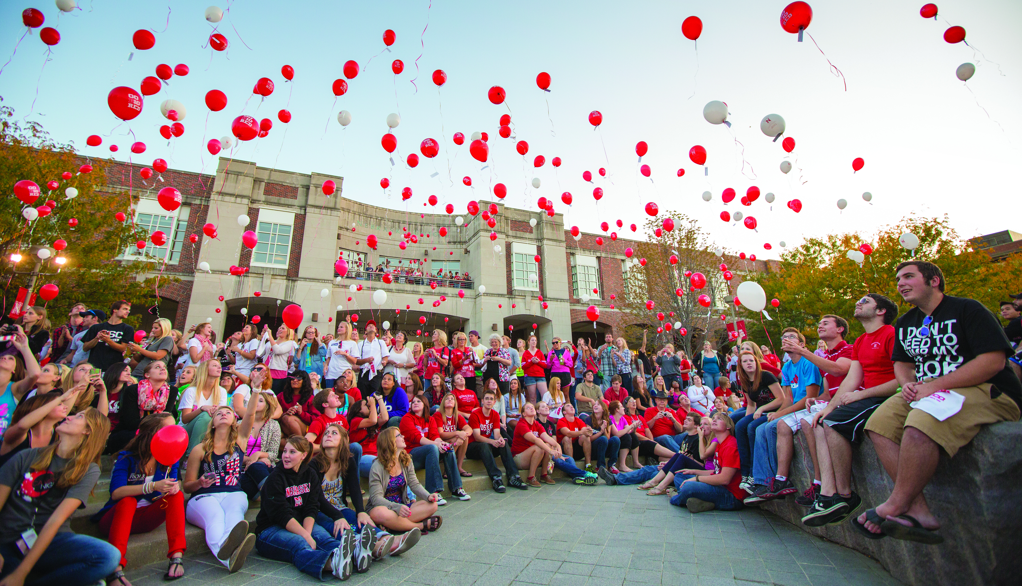
Place Your Title Here
*Poster Author(s) Go Here
**College Department or Affiliations Here
Getting Started
Your poster will be created on one slide in a PowerPoint file. The Pixel Lab needs a file that’s set to your custom page size for proper printing. Therefore, the very first thing you should do is make sure your slide size is the size you want your poster to be printed. This poster is 48" x 36". If your poster needs to be a different size either download one of the other templates or change this file’s document size. Here’s how to change the size: Click the Design tab at the top of the program. Click Slide Size. Select Page Setup. Fill in the correct Width and Height for your poster. Click OK. After clicking ok, PowerPoint may ask you if you’d like to Ensure or Maximize Fit. Select Maximize to increase the size of your slide content when you are scaling to a larger slide size. Select Ensure Fit to decrease the size of your content when scaling to a smaller slide size. (PowerPoint will not let you create posters larger than 56 inches by 56 inches. If your poster needs to be larger than this size create it at a proportional smaller size. We can scale it up to the desired size when we send it to our printers, but only if it is proportional.)
Text
Follow these helpful pointers for your text... Use standard fonts that can be found on Windows and Mac. These include: Arial Tahoma Times New Roman Trebuchet Verdana The title should span the width of the poster and the content should be broken into three to four columns. Adjust the font size depending on the amount of text in your poster and the style of font you choose. For readability, you should not use a font size any smaller than 18 points. For consistency, make all the headers the same font size and all the body text the same font size. If your text is in a different file (e.g. in a Word document) be sure that it pastes into a text box in PowerPoint so it can be more easily edited. To do this, use the Paste Special command and choose Unformatted Text so that the text will become a PowerPoint text box. To create custom bullets in this document, select Format > Bullets and Numbering. Click on picture under Customize and select the image and color you would like to use.
Submitting Posters
Posters can be submitted to either the UNL Pixel Lab or to Dee Ebbeka debbeka1@unl.edu to be printed. You must convert your PowerPoint file (PPT) to a PDF file before you submit it to print. Here’s how to convert your file: Click the File tab. Click Save As. Enter a name for the file in the Save As box, if you haven’t already. Select a file destination on your computer or flash drive. Under the File Format type box, select PDF. Click Save. Once you’ve converted your poster you can submit it to print one of three ways. Here’s how submit your file: Send your PDF poster file via email to debbeka1@unl.edu or pixel-lab@unl.edu. For larger PDF files, upload to our website at pixel-lab.unl.edu, and send us an email that includes all of your information. This template was originally created by the Pixel Lab.
Graphics
Follow these helpful pointers for your graphics... Images copied from the web are low resolution (72 dpi) images and are not good quality for print. Images must be at least 150 dpi to ensure their ability to print. All graphics should be pictures inserted directly into PowerPoint using the Insert>Picture from file option. The preferred image format for all inserted images is JPEG. TIF files will also work. (tif files have transparent backgrounds and jpg files do not.) Avoid png and gif files. Do not scale images larger than 110% after they have been inserted into PowerPoint. They will lose quality and become pixelated. To scale an image and retain its proportion, hold down the shift key on your keyboard while clicking on one of the corners with your mouse and dragging. If you have graphs or charts from Excel that need to be included in your poster, simply copy in Excel and paste into PowerPoint. You can bring in graphs and charts from Word by choosing Insert>Object… and choosing Microsoft Word Document. This will maintain the quality of your document and keep the background transparent.
Design Tips
To prevent cropping when printing, be sure there is nothing important, such as text, within 1" of the edges of the poster. A gradient color fill in the background, especially black, will print poorly. The colors that you see on your computer monitor will not reproduce exactly the same on a printed poster, as monitor color settings vary. Inform us of any important colors. Scarlet is the official color of the University. To find more University colors visit: ucomm.unl.edu/toolbox/colors
GENERAL FONT SIZES
SECTION | FONT SIZE
Main Title | 72-120 pt
Subtitle/Authors | 48-80 pt
Section Headers | 36-72 pt
Body Text | 24-48 pt
Acknowledgments and sources can be a smaller size than the main copy if necessary.
QUESTIONS?
If you have questions, we’re here to help! Stop by, give us a call, or send us an email. We’re happy to help you if you have questions about design, Microsoft Office, or Adobe programs.

