Slide 1
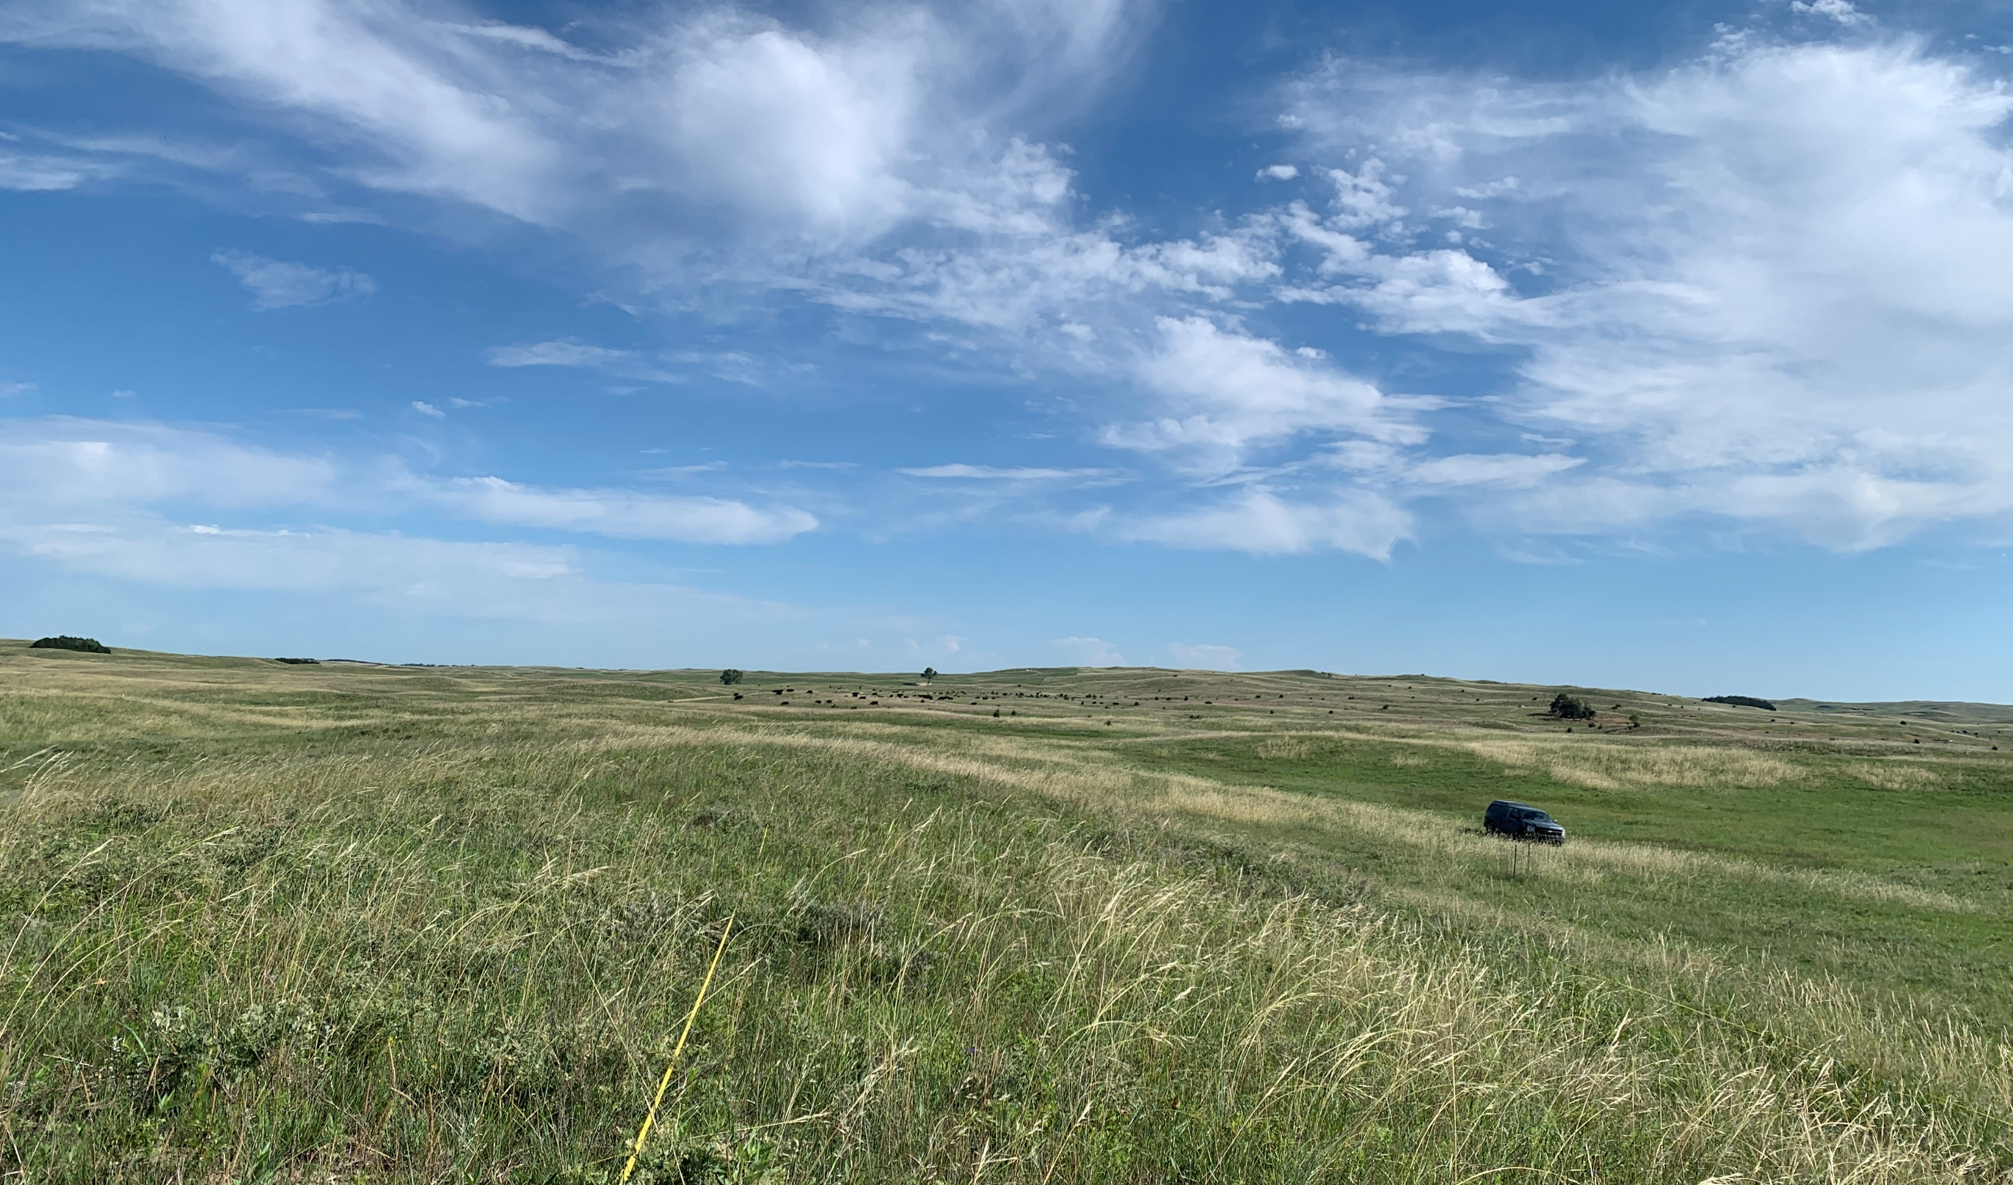
From Pixels to Pastures: A Remote Sensing Perspective on Sandhills Complexity
Catherine Chan
Graduate Student Seminar

Slide 2
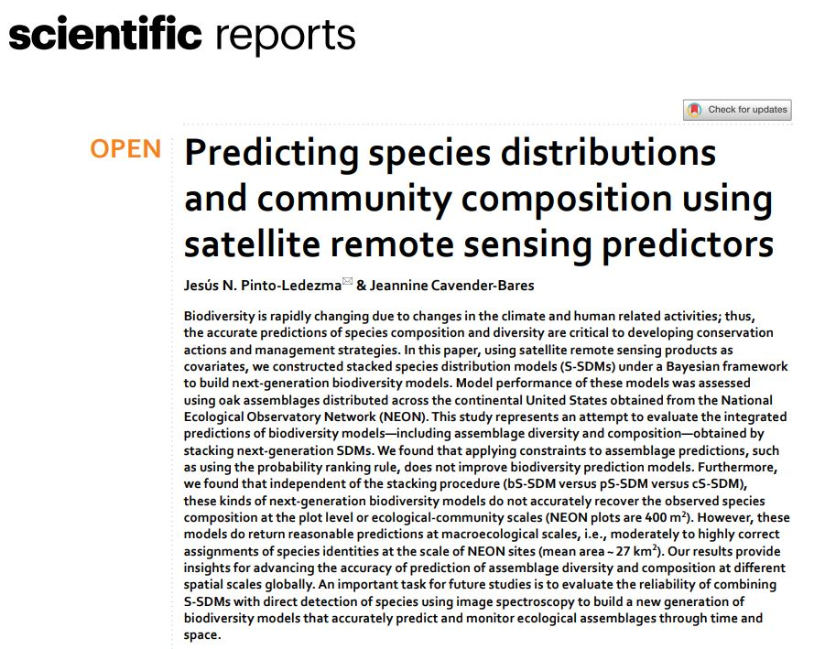
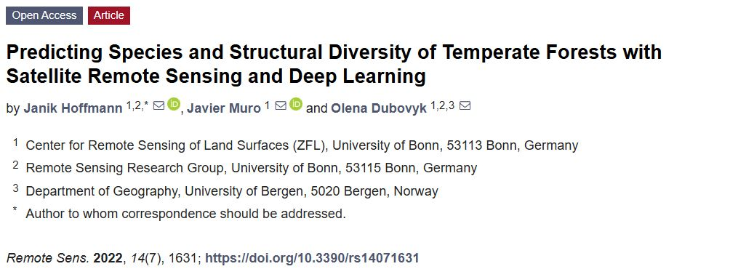
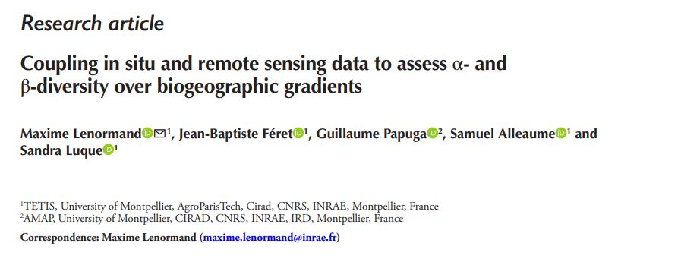
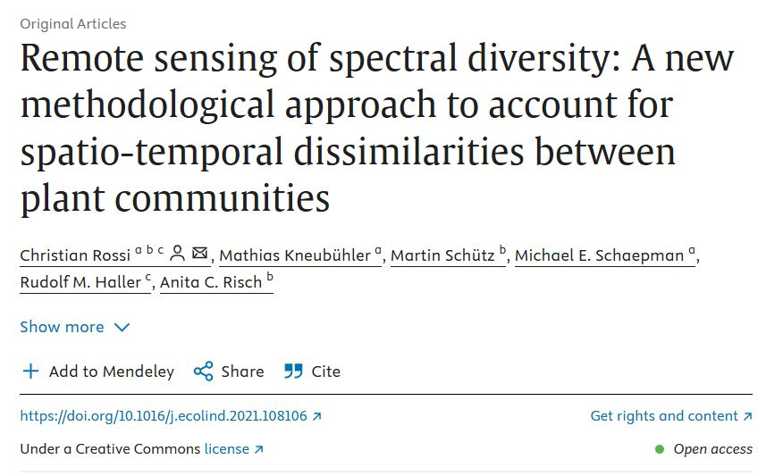
Remote sensing (RS) of biodiversity
The importance of biodiversity
RS of biodiversity; various methods and scales
1) What gets published/shared?
2) Going beyond ‘remote sensing signal as a predictor of biodiversity.’

Slide 3
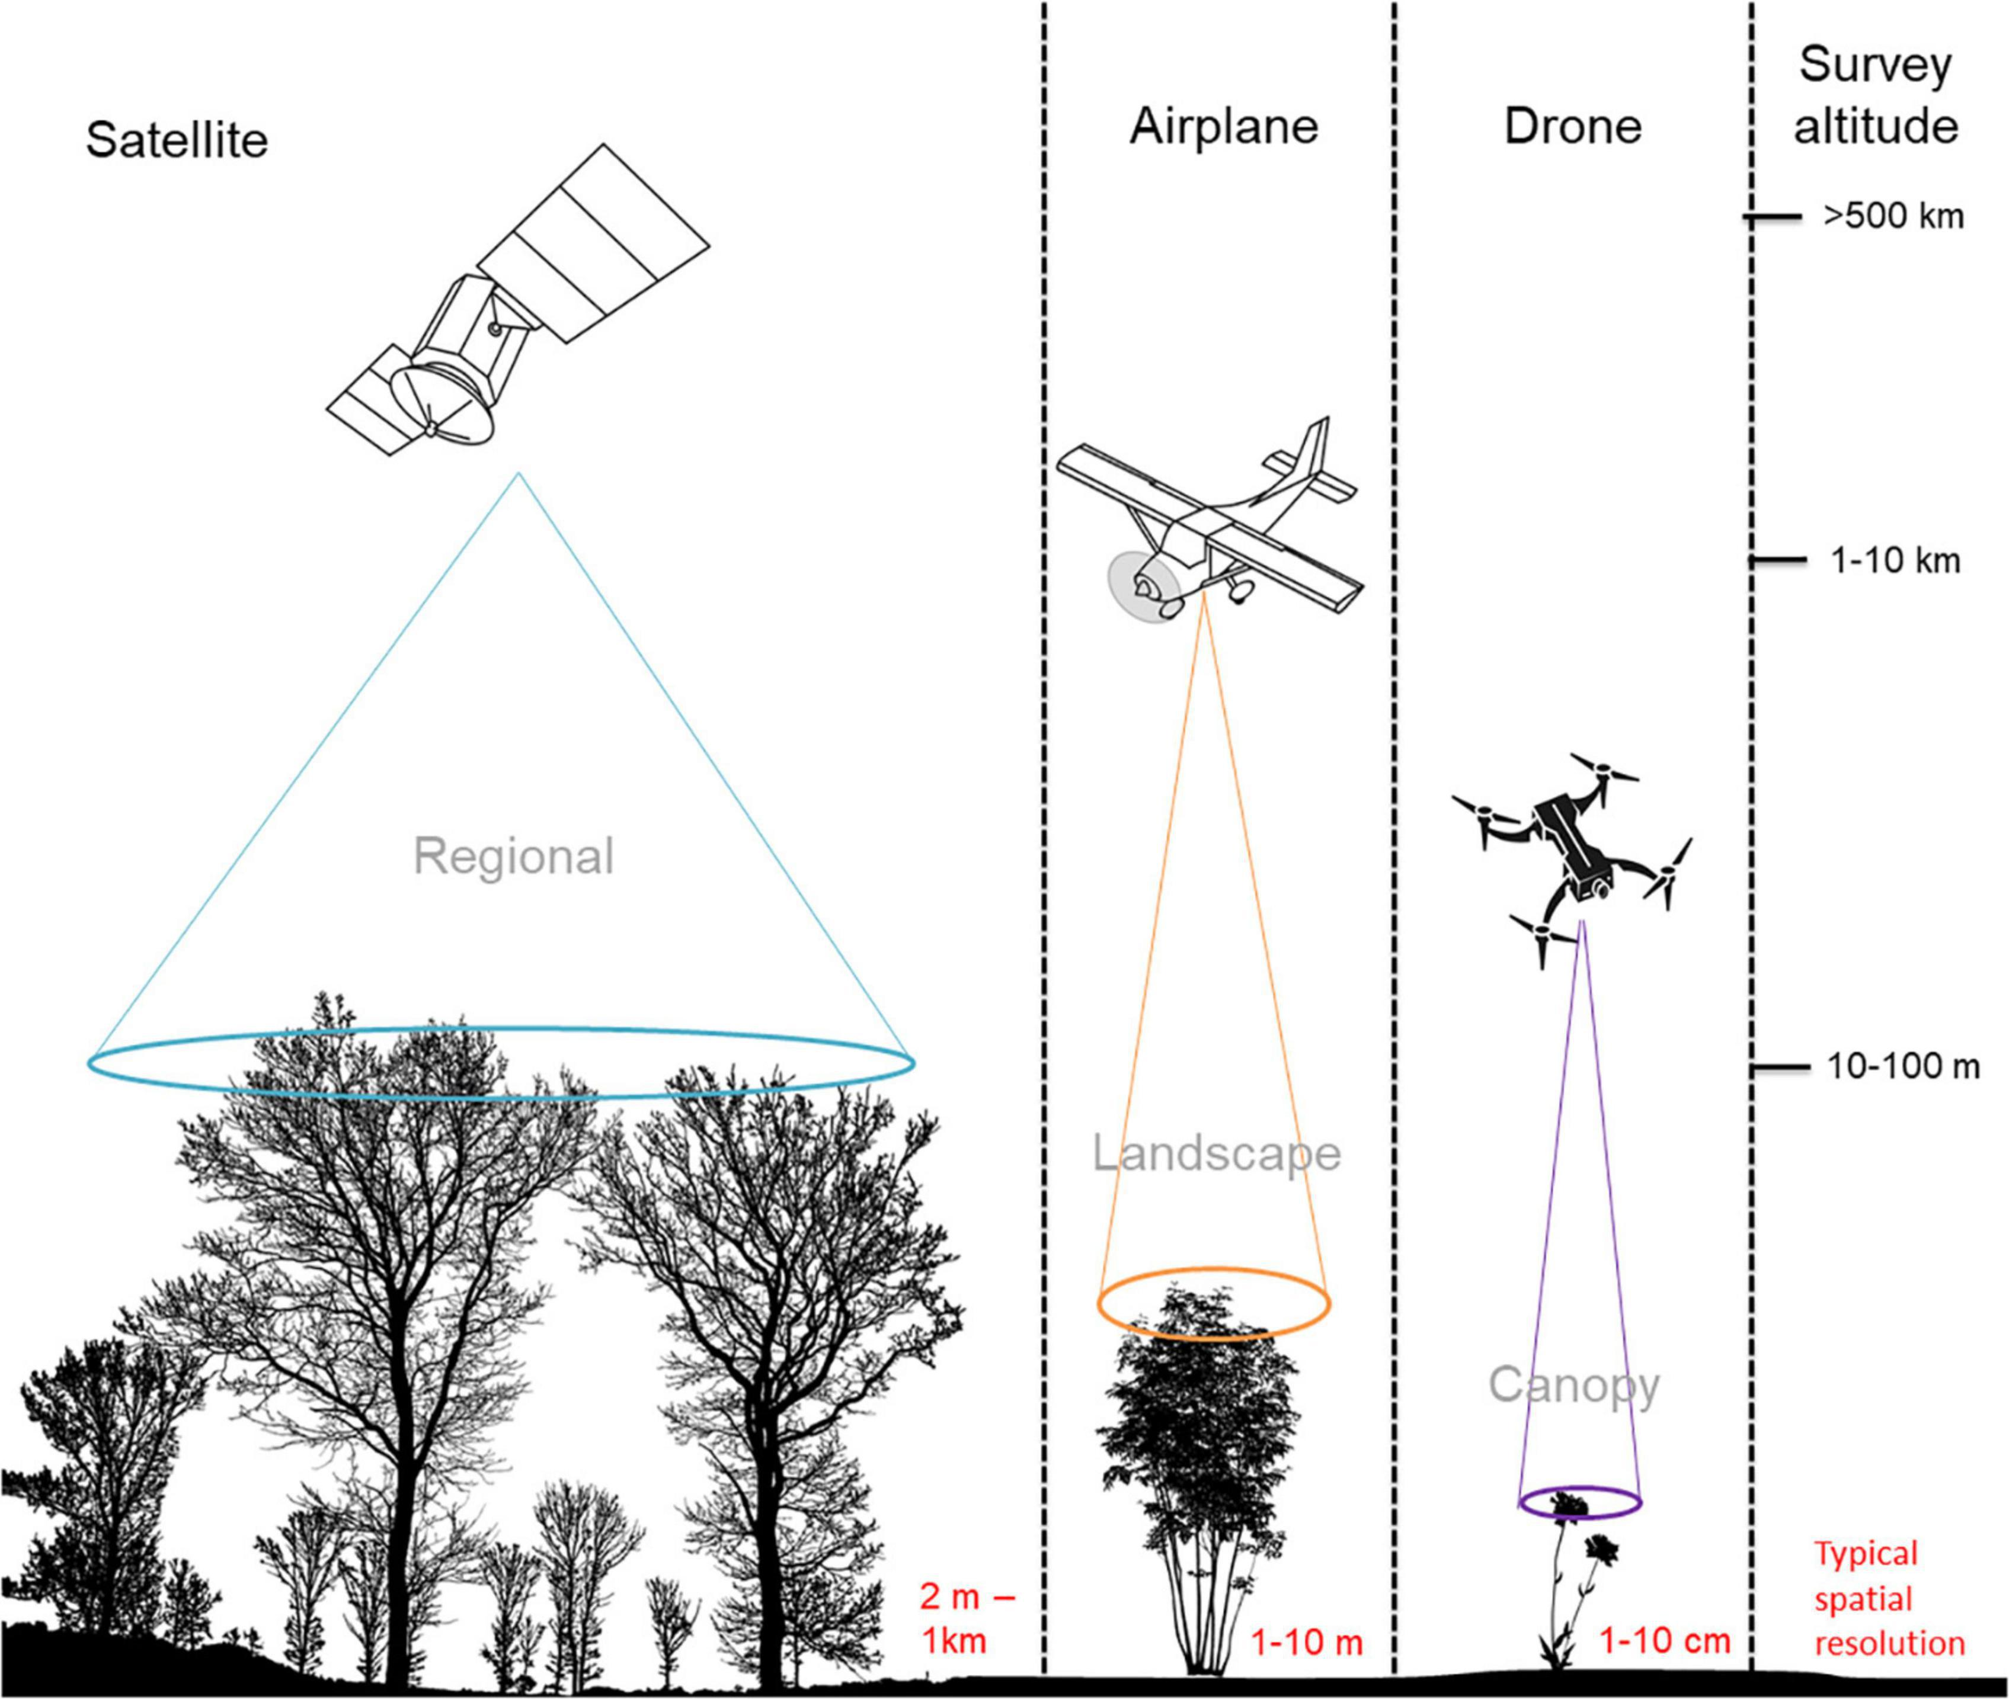
Remote sensing data
Platforms
Drones
Aircrafts (planes)
Watercrafts (boats)
Satellites
Sensors
LiDAR
Multispectral
Hyperspectral
Thermal
Gonzales et al., 2022

Slide 4
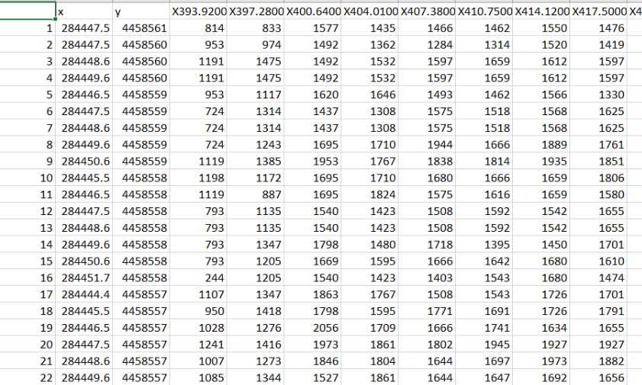
Remote sensing data
Imaging spectroscopy
Study of physical interaction between light energy and an object
Platforms
Drones
Aircrafts (planes)
Watercrafts (boats)
Satellites
Sensors
LiDAR
Multispectral
Hyperspectral
Thermal
Columns: bands at wavelength
Rows: pixels
This dataset is 263580 x 138

Slide 5
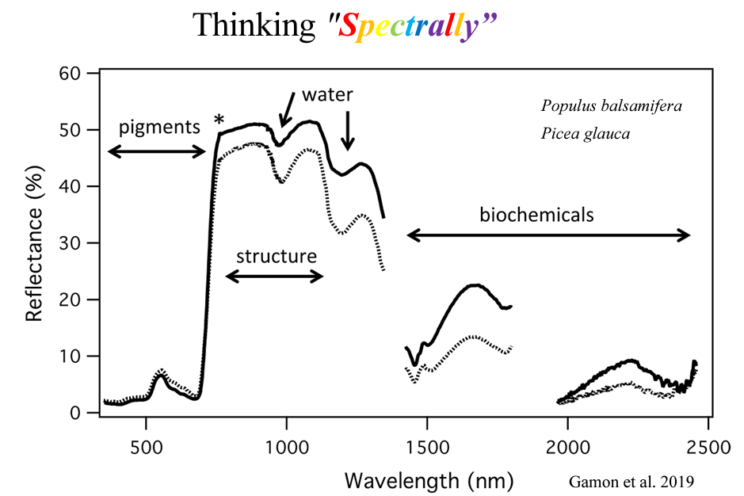
Imaging spectroscopy
Columns: bands at wavelength
Rows: pixels

Slide 6
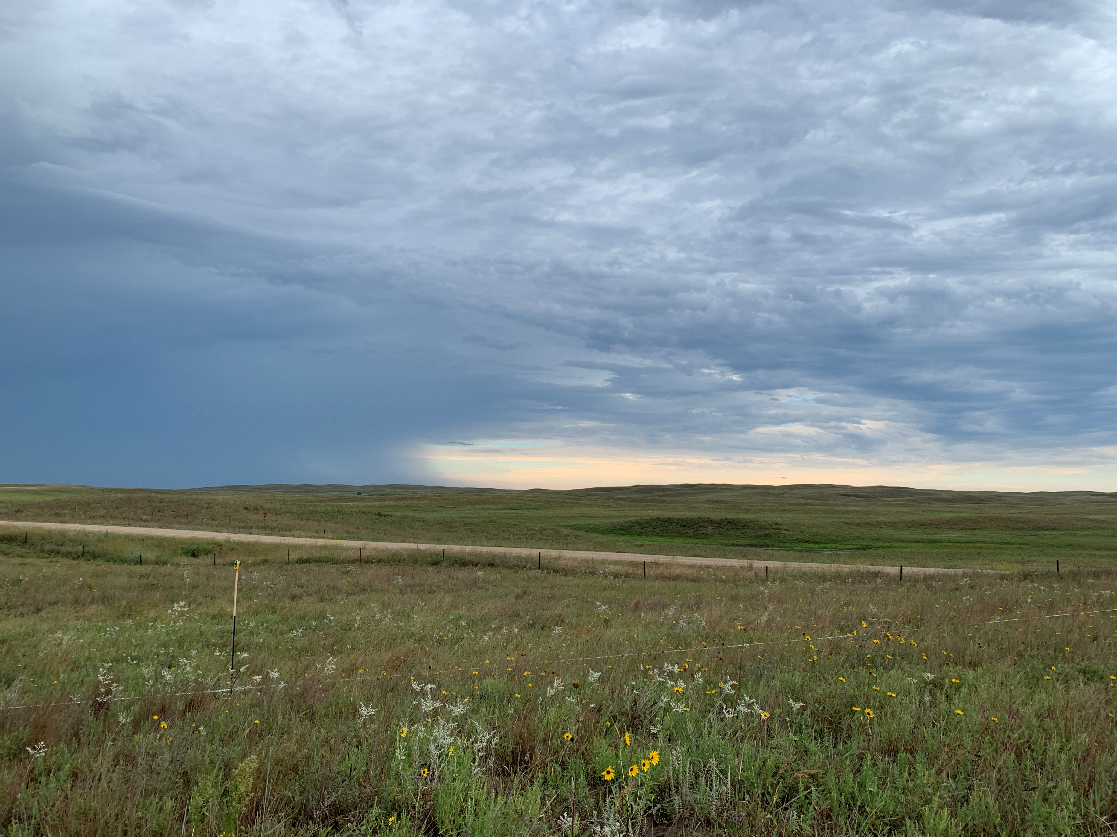
The remote sensing conundrum
The challenge (and theme) of RS is that remotely sensed metrics are not direct measurements.
They act as proxies of something else.
→ What are the factors impacting the relationship between the remote sensing signal and biodiversity?

Slide 7
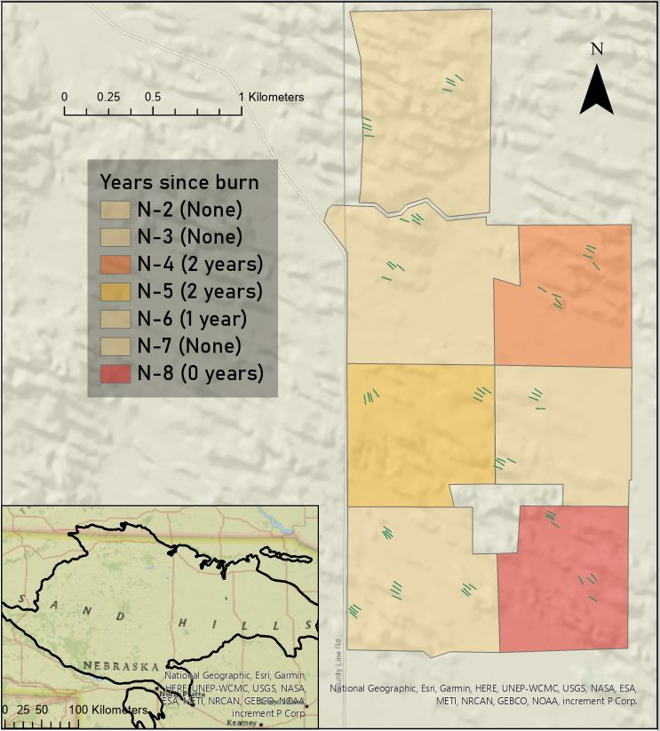
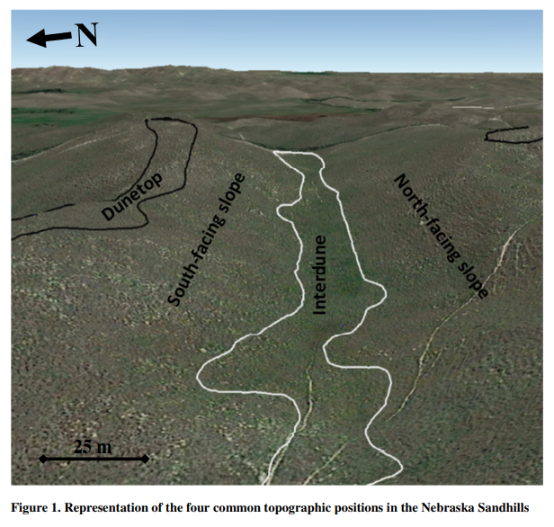
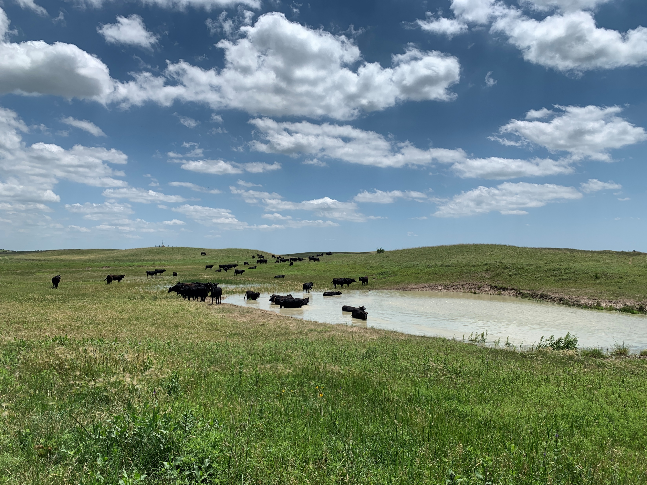
Barta Brothers Ranch
Stephenson et al., 2019
Stephenson et al., 2019
Schacht et al., 2000

Slide 8
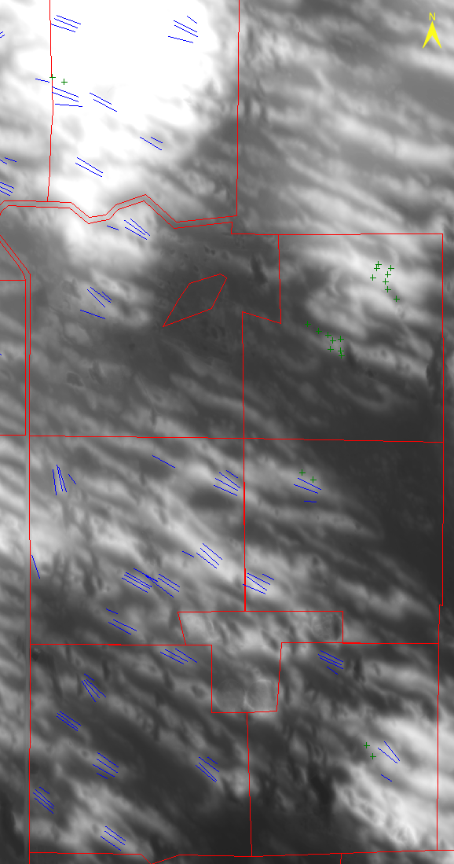
Landscape
N2
Dune position
Dune top
North facing slope
South facing slope
Interdune
Digital elevation model
Elevation
N3
N4
Stephenson et al., 2019
N5
Schacht et al., 2000
N6
N7
N8

Slide 9
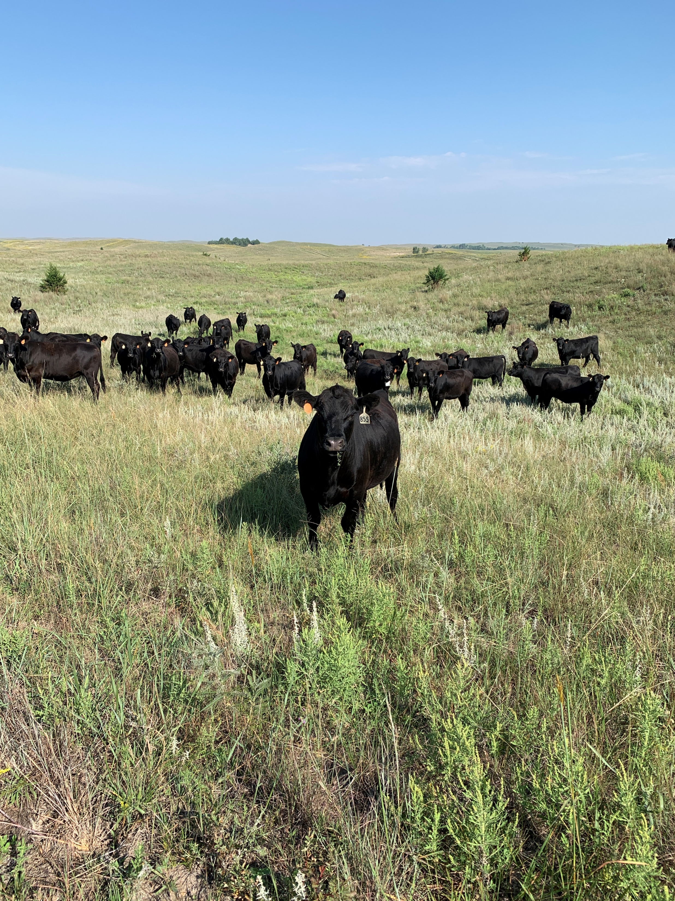
Management
Deferred
rotational
N2
Grazing
Deferred rotational
Patch burn grazing
Prescribed burning
N3
N4
Pasture | Grazing treatment | Burn treatment
N2 | Stocking 0.78 aum | None
N3 | Stocking 0.78 aum | None
N4 | Stocking 0.78 aum | Burned 2023
N5 | Stocking 0.71 aum | Burned 2022
N6 | Stocking 0.71 aum | Burned 2023
N7 | Stocking 0.71 aum | None (projected 2025)
N8 | Stocking 0.71 aum | Burned 2024
N5
N6
Patch burn grazing
N7
N8

Slide 10
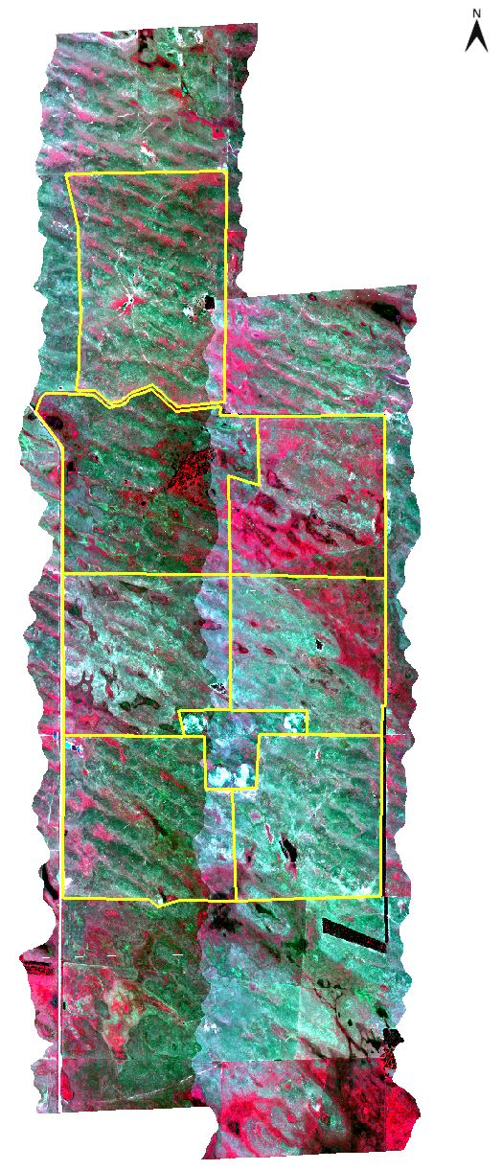
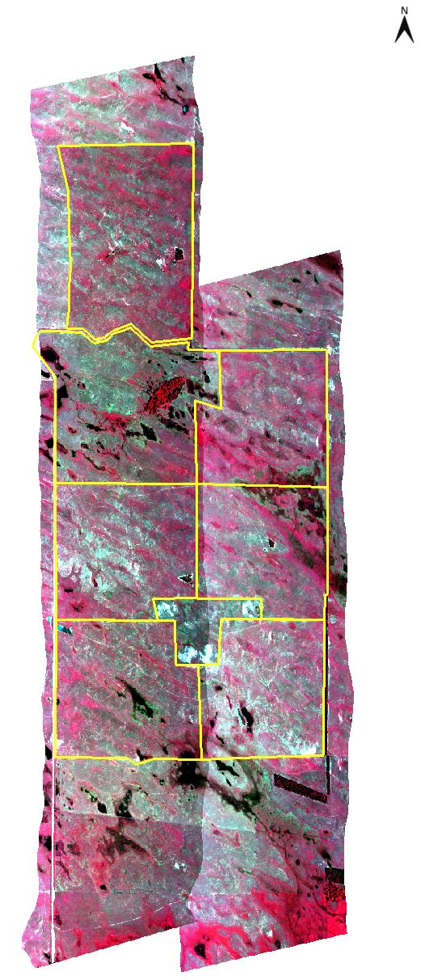
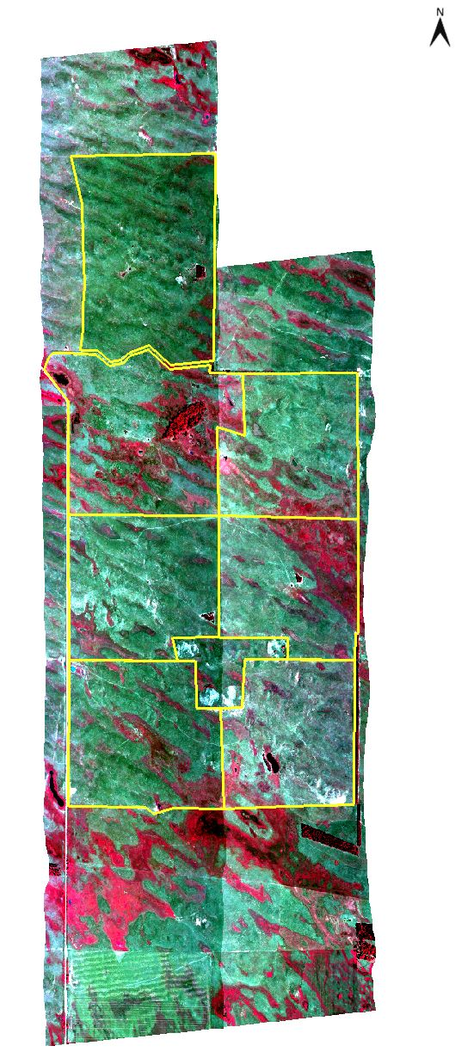
Spectral images
July 2023
June 2024
August 2024
AISA Kestrel
178 bands
400-1000 nm
Coefficient of variation (CV)
NDVI

Slide 11
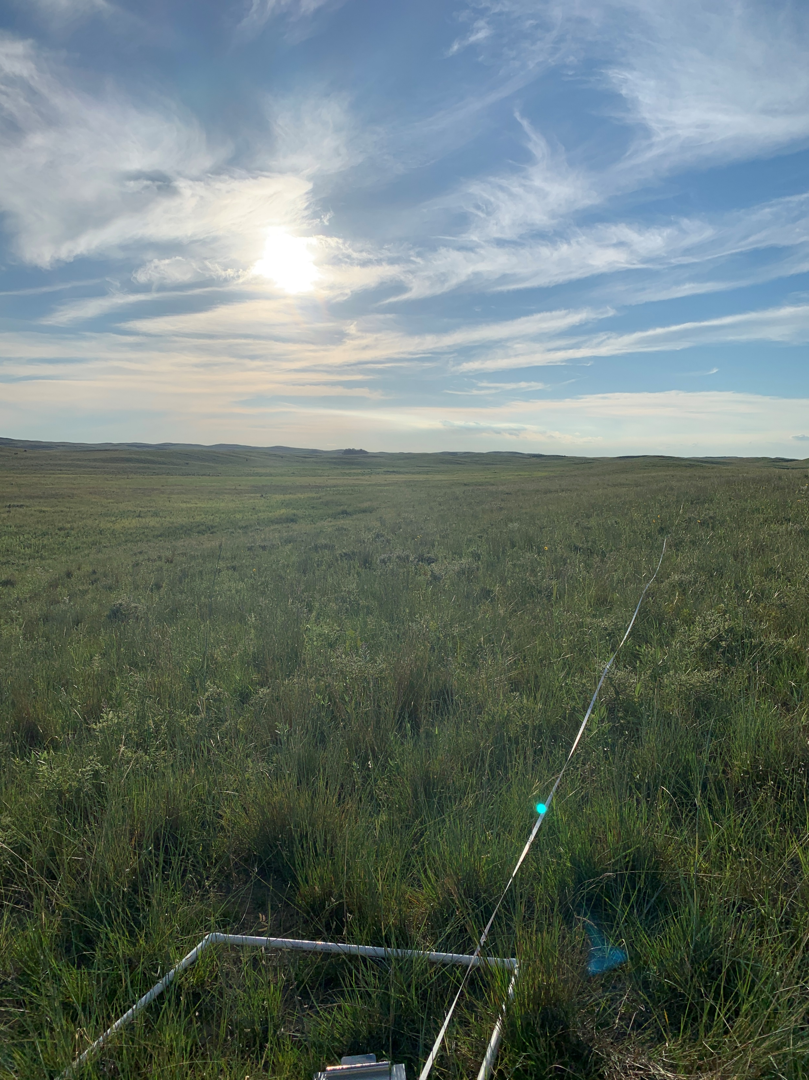
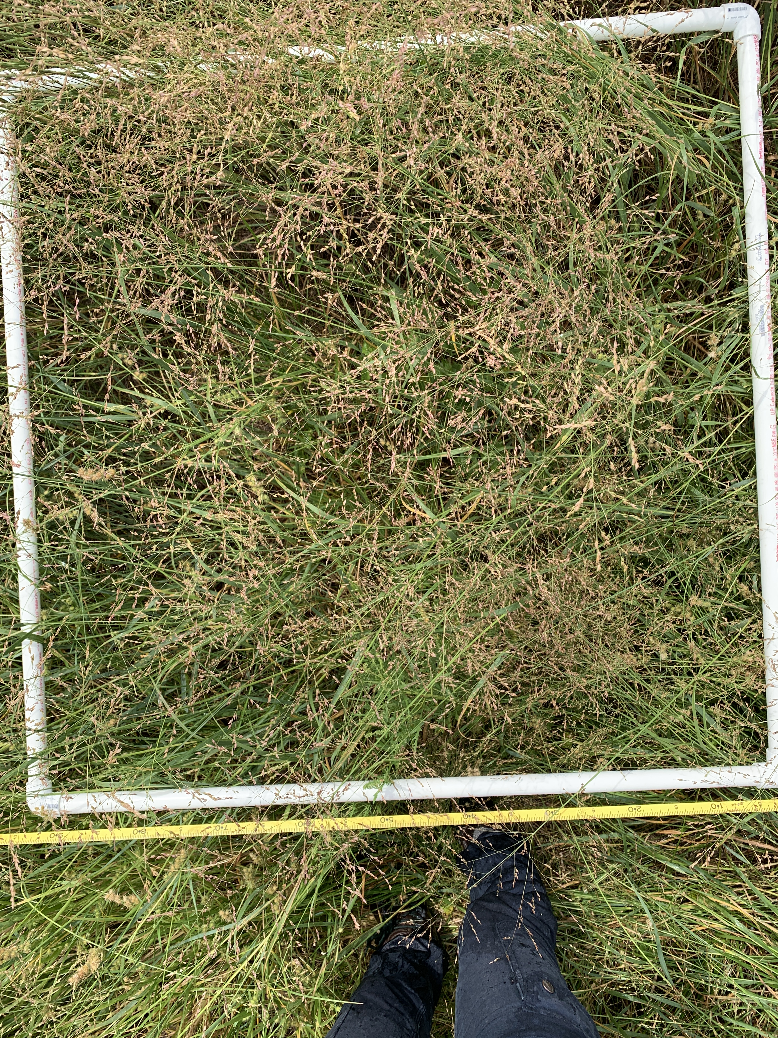
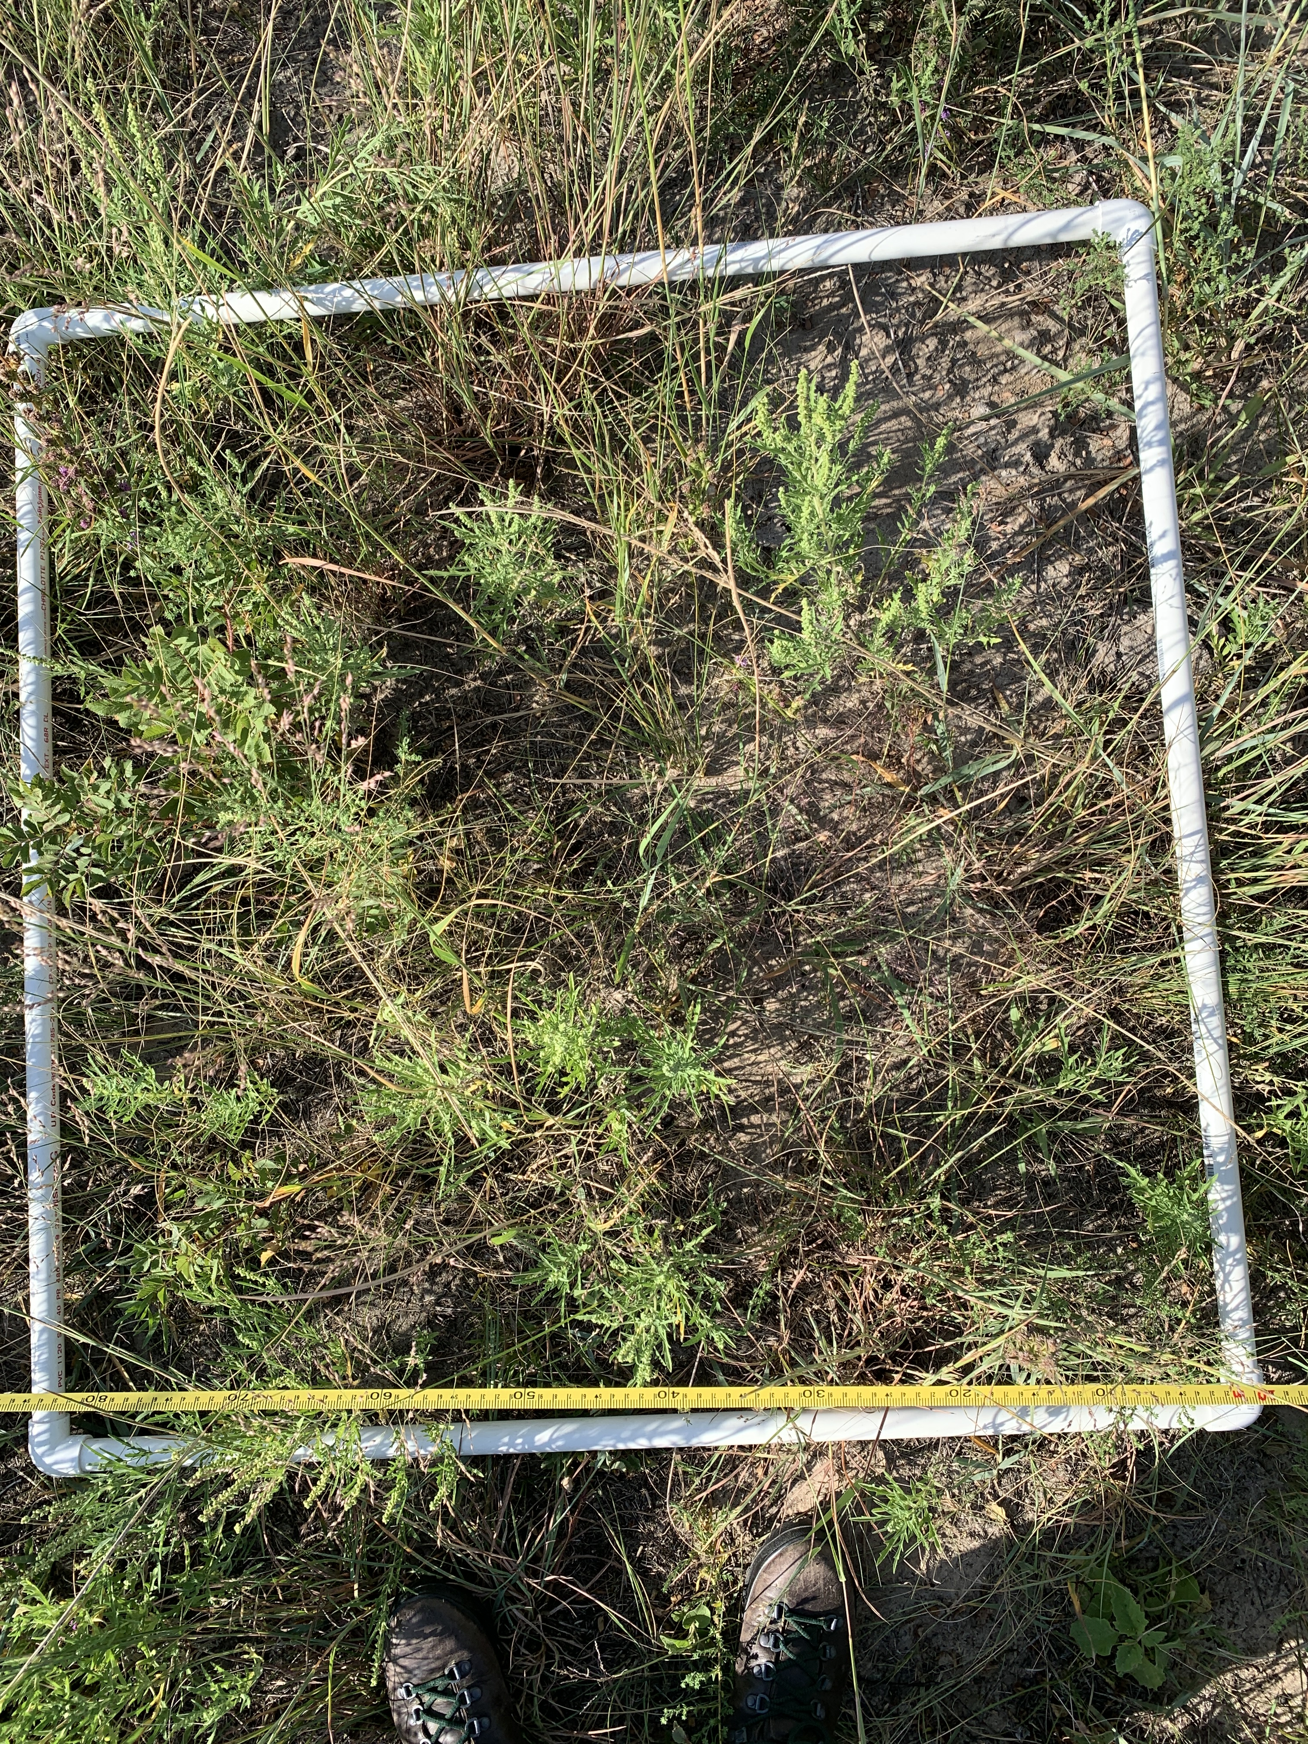
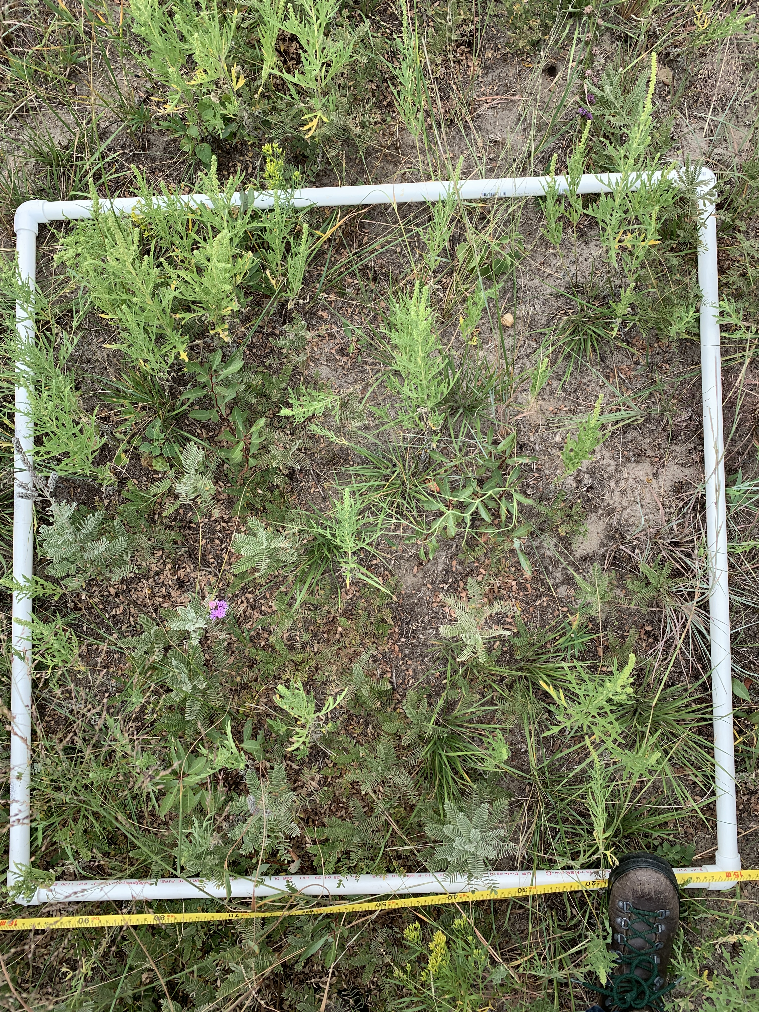
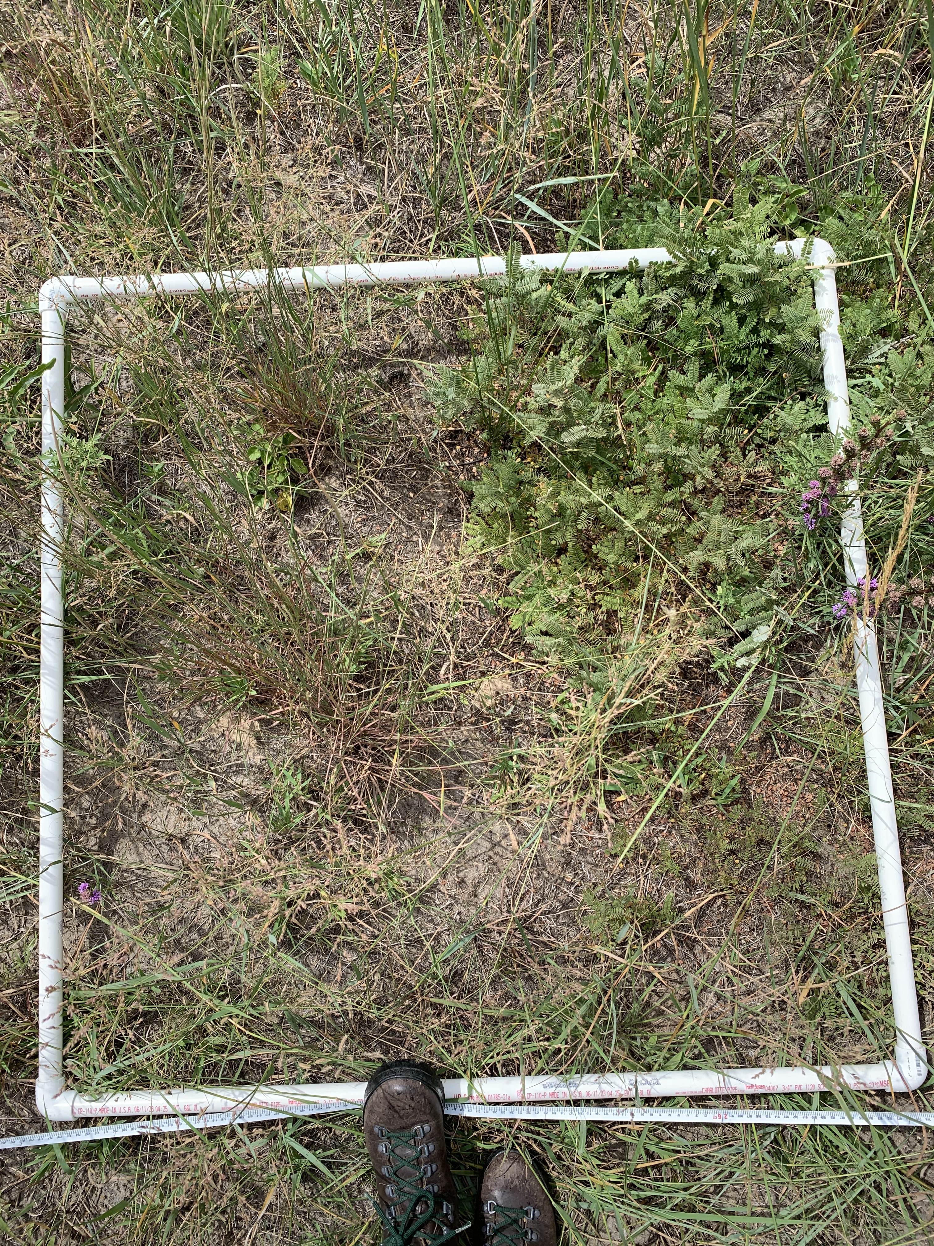
Plant species data
1-m quadrats, 5-m on 50-m transects
Species count and percent cover
Percent bare ground
Percent litter (dead standing included)
July 2023, June 2024, August 2024
Shannon diversity index
N4 ID
N4 DT
N4 NS
N4 SS

Slide 12
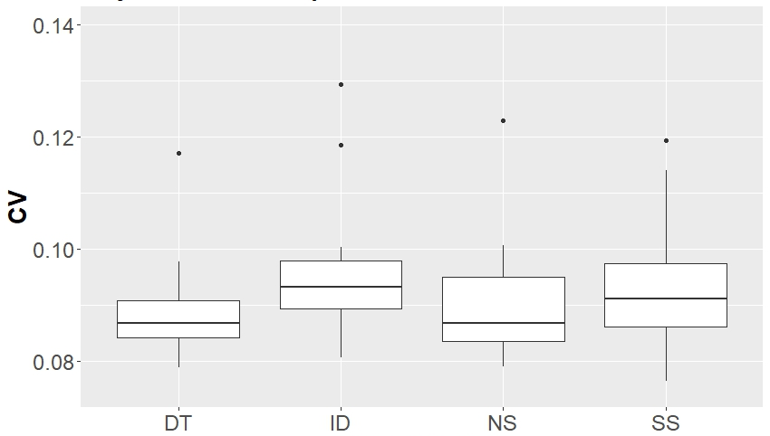
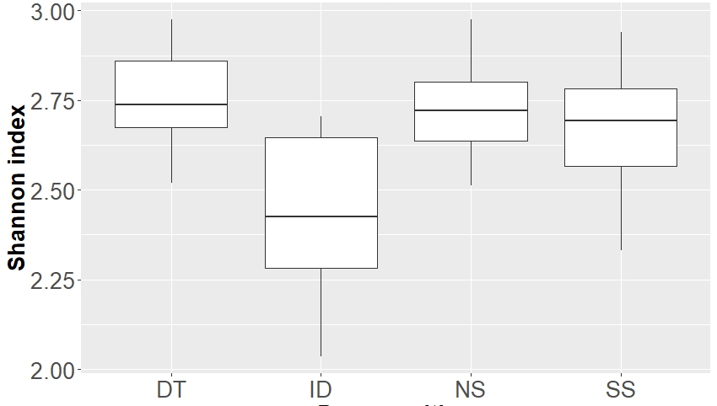
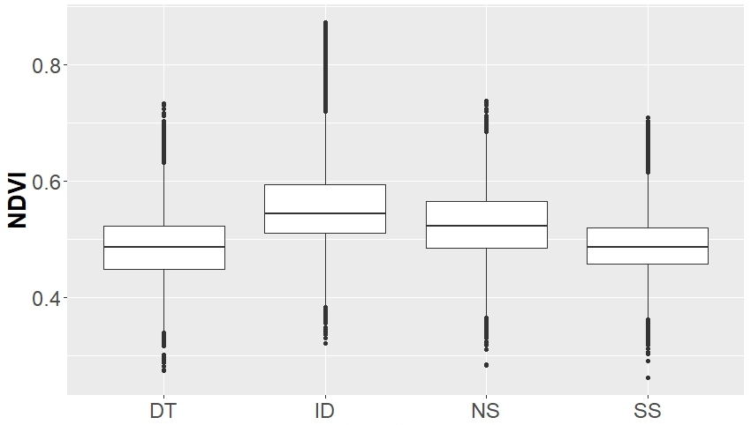
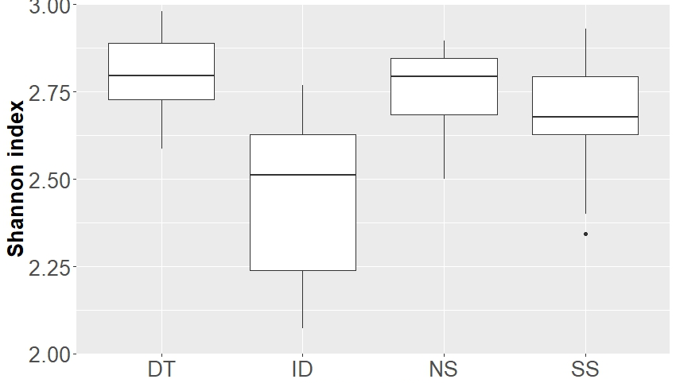
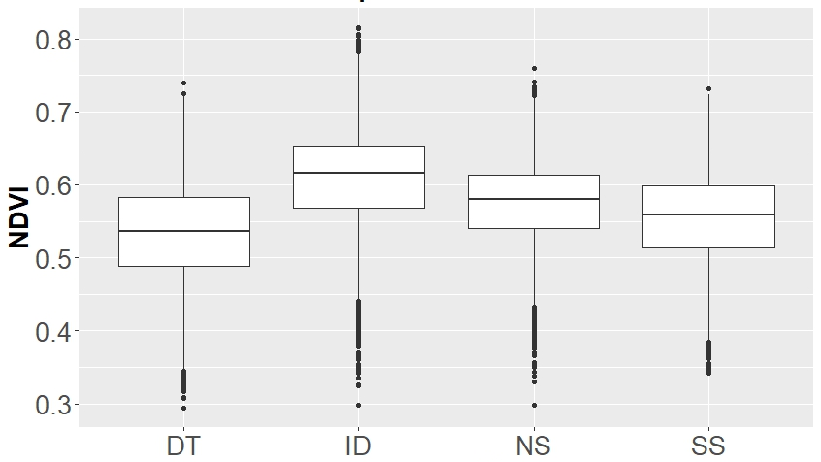
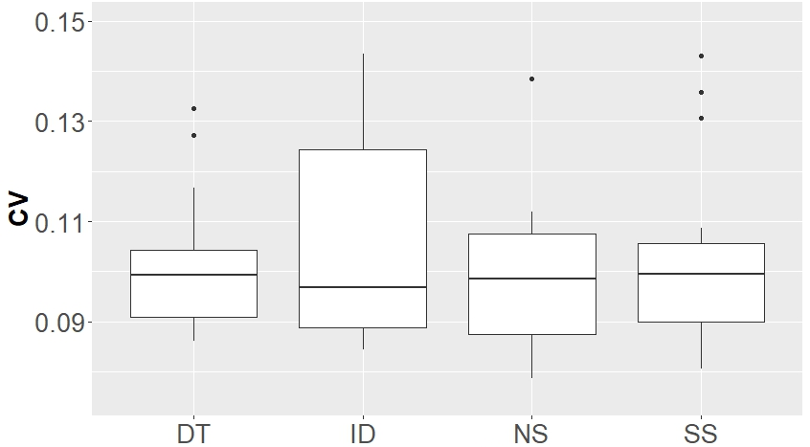
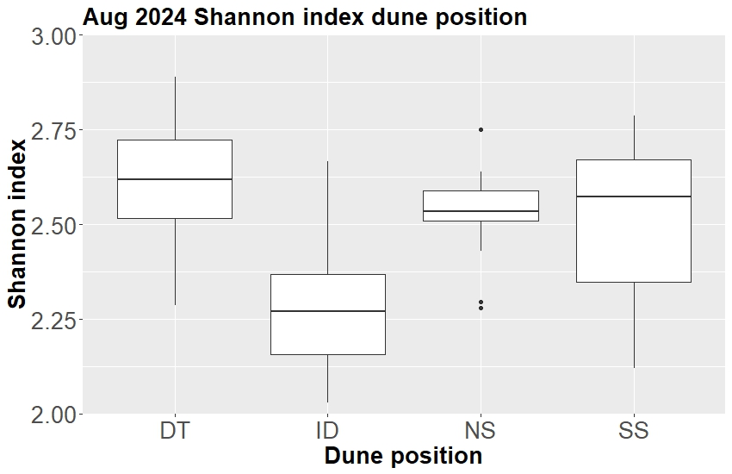
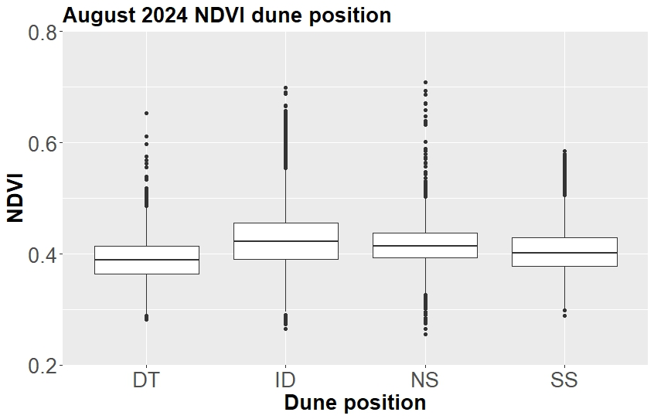
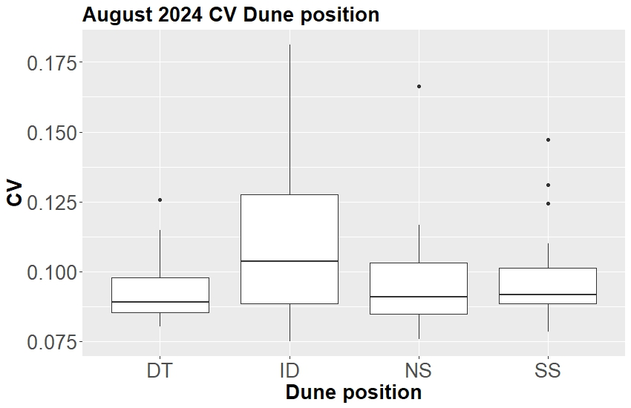
Shannon index
NDVI
CV
July
2023
June
2024
August 2024
12

Slide 13
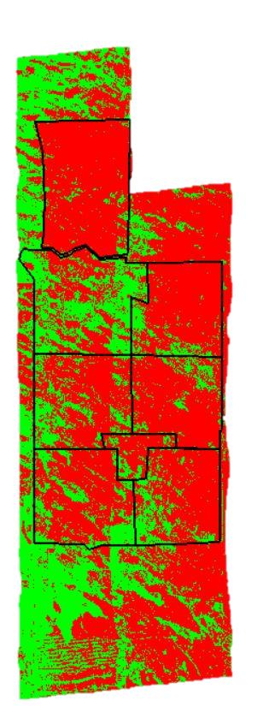
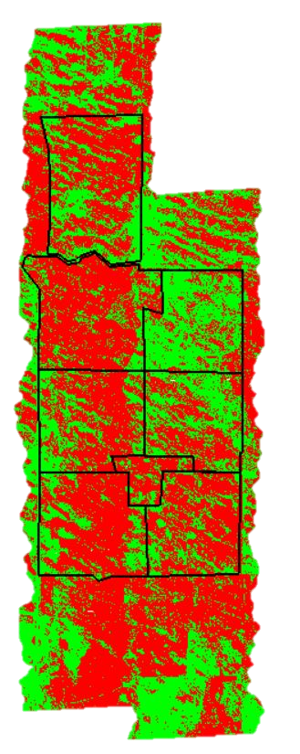
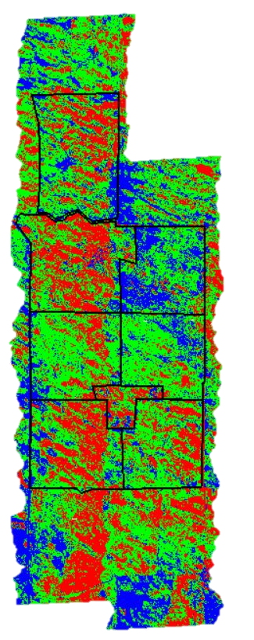
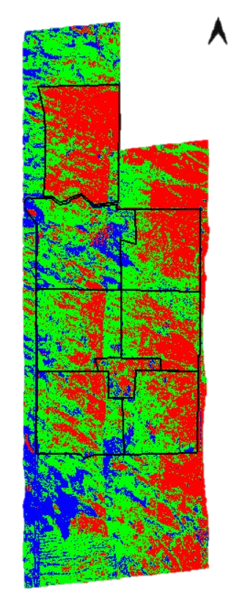
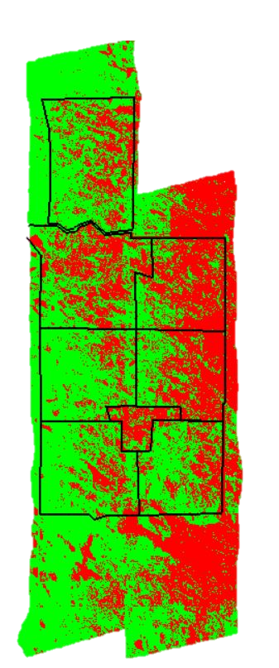
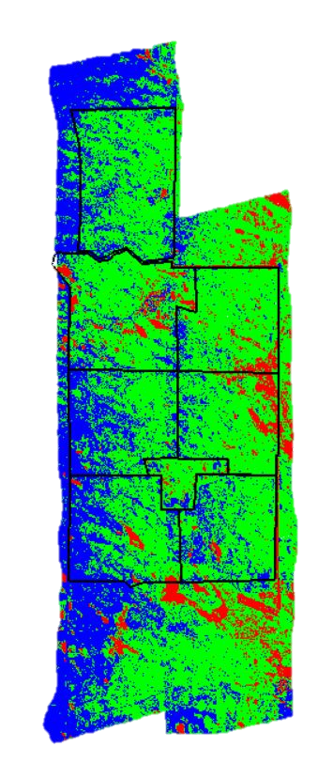
Image Cluster analysis
Jul23 Kmeans2
Jun24
Kmeans2
Aug24
Kmeans2
Jul23 Kmeans3
Jun24 Kmeans3
Aug24 Kmeans3

Slide 14
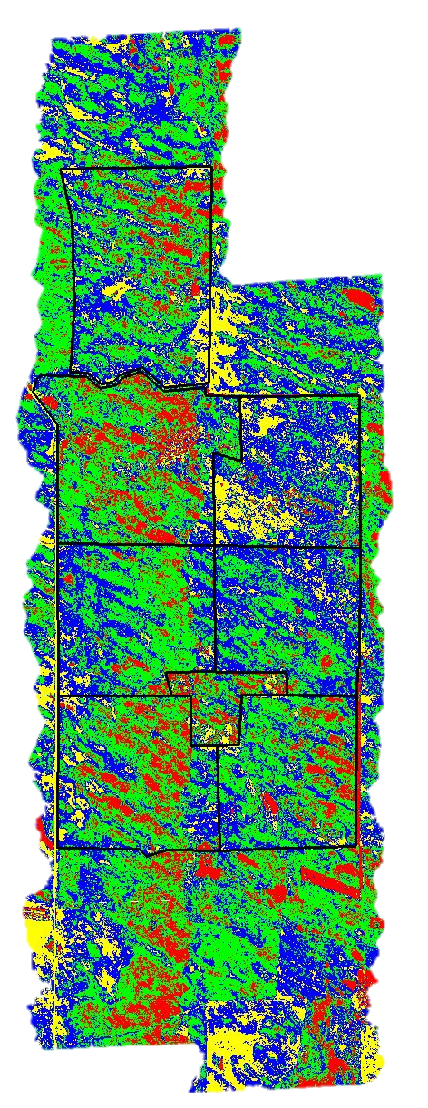
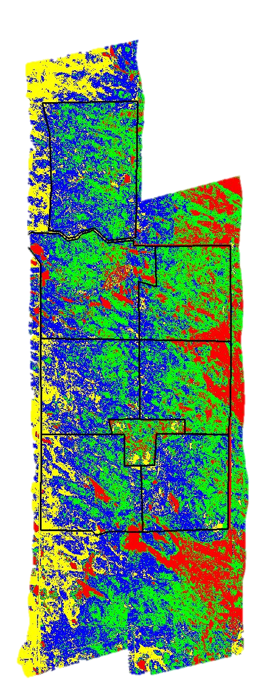
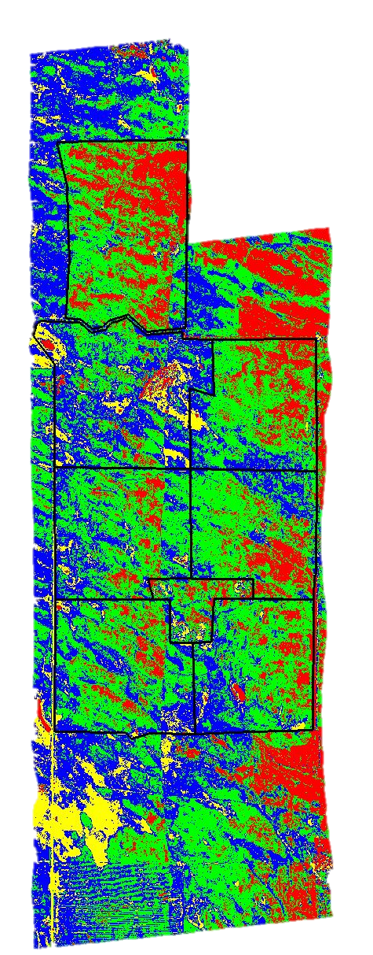
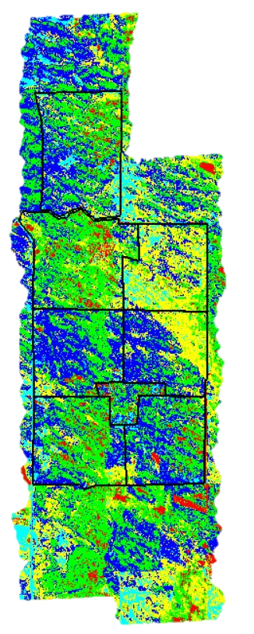
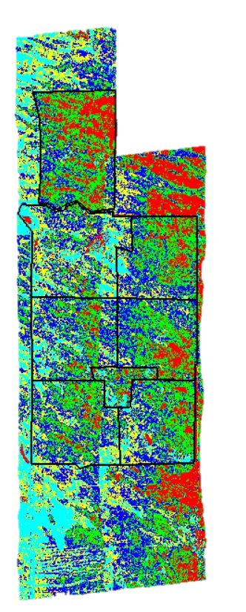
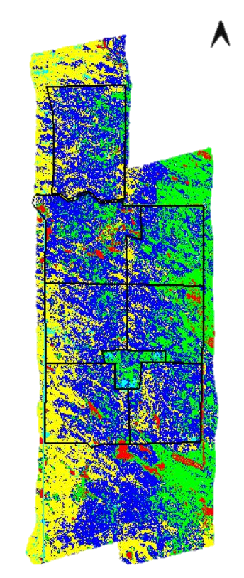
July23 Kmeans4
Jun24 Kmeans4
Aug24 Kmeans4
Jul23 Kmeans5
Jun24 Kmeans5
Aug24 Kmeans5

Slide 15
Cattle movement
May 22, 2024 - June 23, 2024
May 22, 2024 - August 29, 2024

Slide 16
Landscape characteristics
and management
Plant diversity
Spectral reflectance

Slide 17
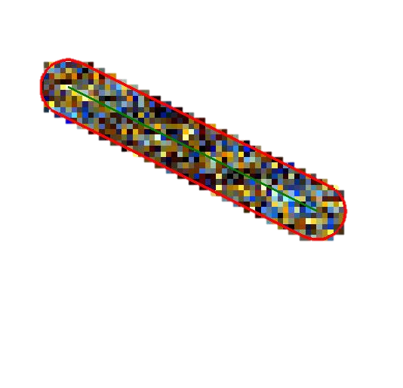
Calculating image-sampled metrics
10 slices
20 slices

Slide 18
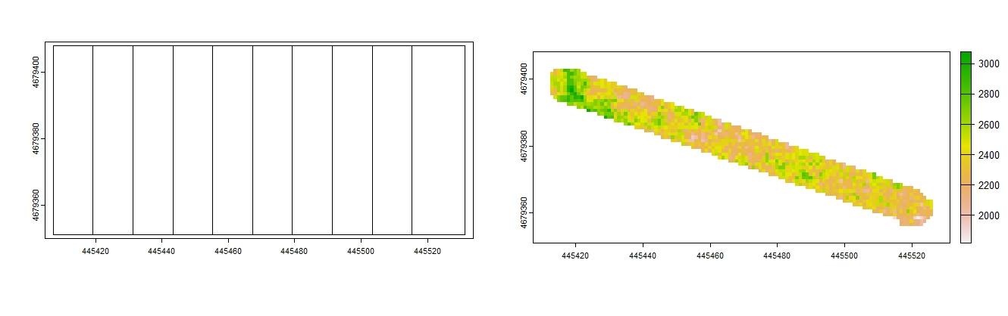
An attempt

Slide 19
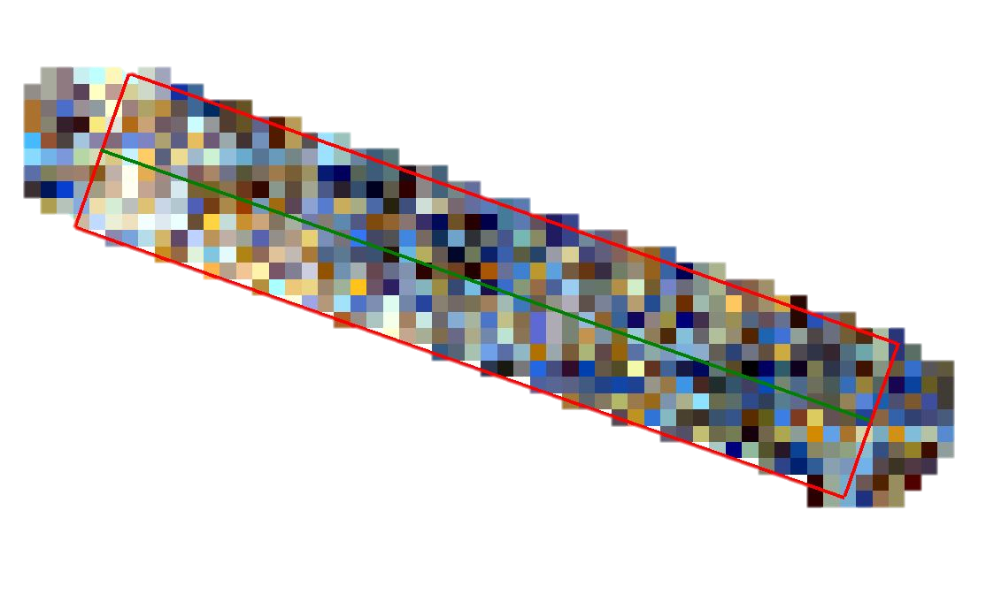
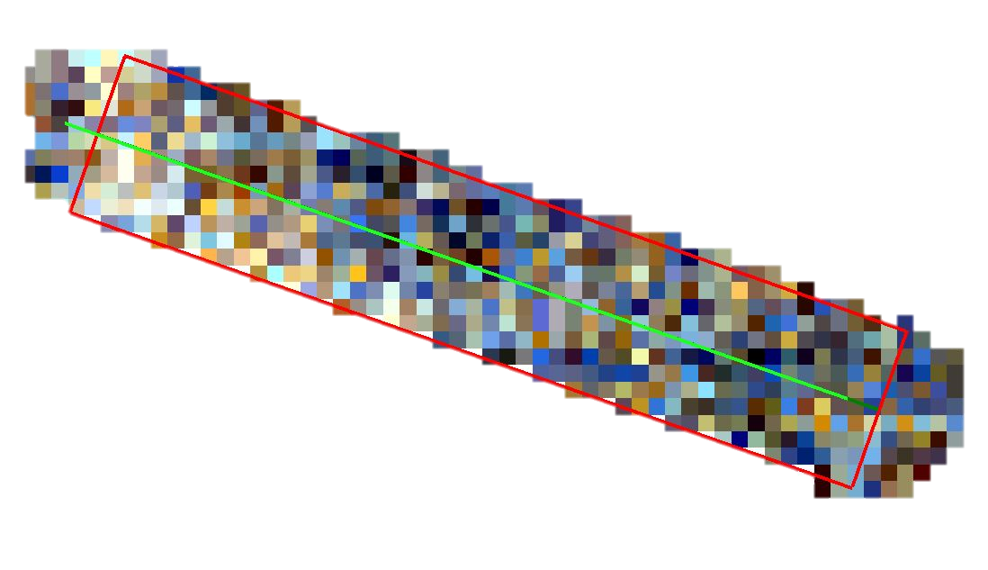
Calculating image-sampled metrics

Slide 20
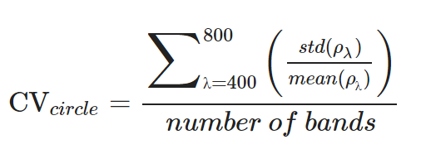
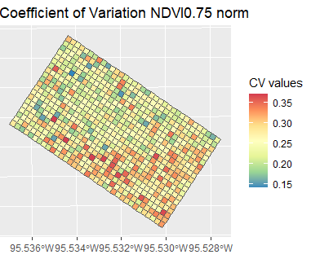
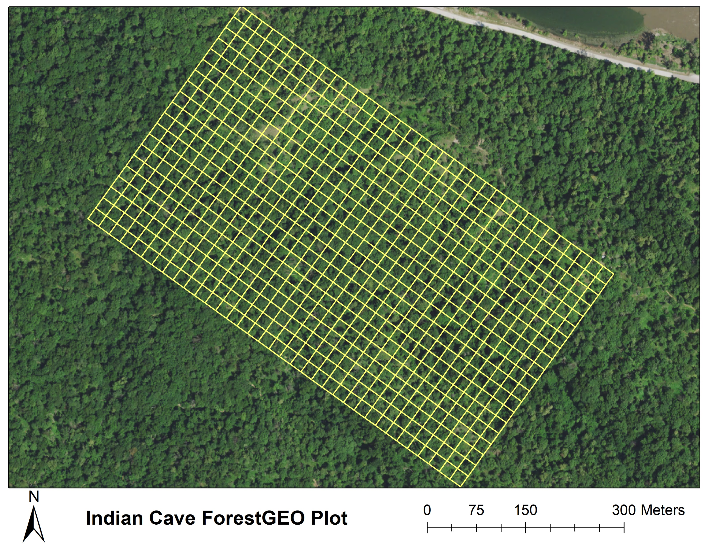
Estimate biodiversity using spectral data in a deciduous ecotonal environment
Ground data: Species richness, Shannon’s index, Shannon’s index on basal area, stem density, basal area, evenness
RS data: Coefficient of variation
Wang et al. (2016)
Coefficient of variation – spectra
Wang & Russo

Slide 21
Thanks!

