Slide 1
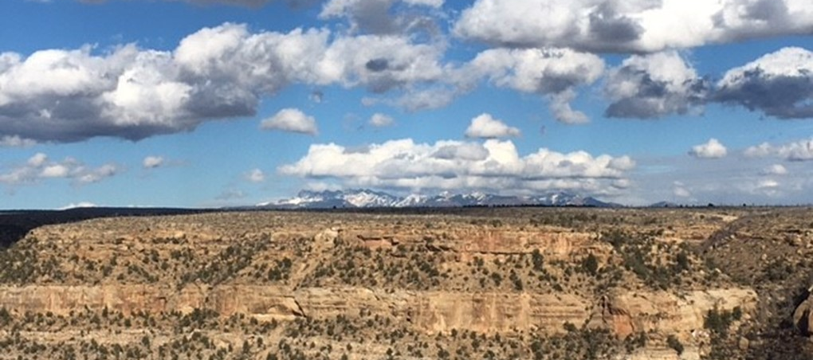
Climate Literacy in Natural Resources
NRES 208 || 3 credit hours
Explore how climate shapes the world and its natural resources
Understand
Earth’s climate system
Earth’s six interconnected spheres
Challenges of climate change
Required for Environmental Science major & Applied Climate Science minor
No Prerequisites
Fall 2025
MWF 9-9:50
163 Hardin Hall
Questions? Michael Hayes mhayes2@unl.edu

