Slide 1
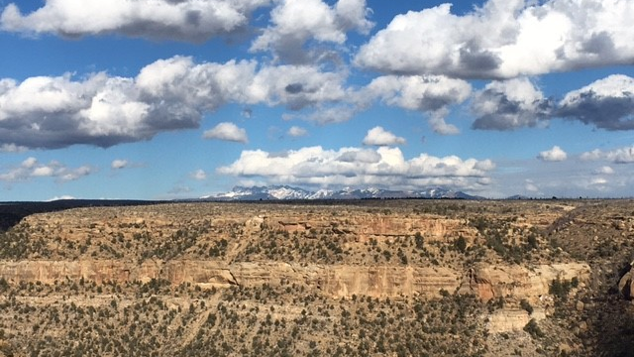
Climate Literacy in Natural Resources NRES 208 || 3 credit hours
For students who want to learn about climate and its impacts on our natural resources. You will develop an understanding of the climate system and the interactions with the environment. It is a required class for the Environmental Science major and the Applied Climate Science minor.
Fall 2025
MWF 9-9:50
163 Hardin Hall
Questions? Contact Michael Hayes at mhayes2@unl.edu
Outcome one: knowledge regarding the climate system and the issues of climate variability and change.
Outcome two: knowledge of the six different spheres of the climate system: atmosphere, hydrosphere, biosphere, cryosphere, lithosphere, and anthroposphere.
Outcome three: understanding of the key linkages between climate and natural resources.
PREREQUISITE:
None

